Slide 1
MCA Final Year Project (Review II) Rebil
Submitted to the Presidency University, Bengaluru in partial fulfilment for the award of the degree of Master of Computer Applications(MCA)
Project Number : MCA_PR216
Under the supervision of
Mr. Sakthi S Asst.Prof-SCSE Presidency University
Name | Roll Number
DEEPAK KUMAR SINGH D | 20232MCA0198

Slide 2
Content
Problem Statement
Screenshots
Github Link

Slide 3
Problem Statement
Fragmented HR Systems: Traditional HR processes are often disjointed, leading to inefficiencies.
Manual Data Handling: Reliance on spreadsheets and paperwork increases the risk of errors and data redundancy.
Delayed Hiring Decisions: Ineffective recruitment tracking slows down the hiring process.
Compliance Risks: Difficulty in ensuring adherence to company policies and industry standards.
Lack of Centralized Control: Absence of a unified platform hampers smooth HR operations and data accessibility.

Slide 4
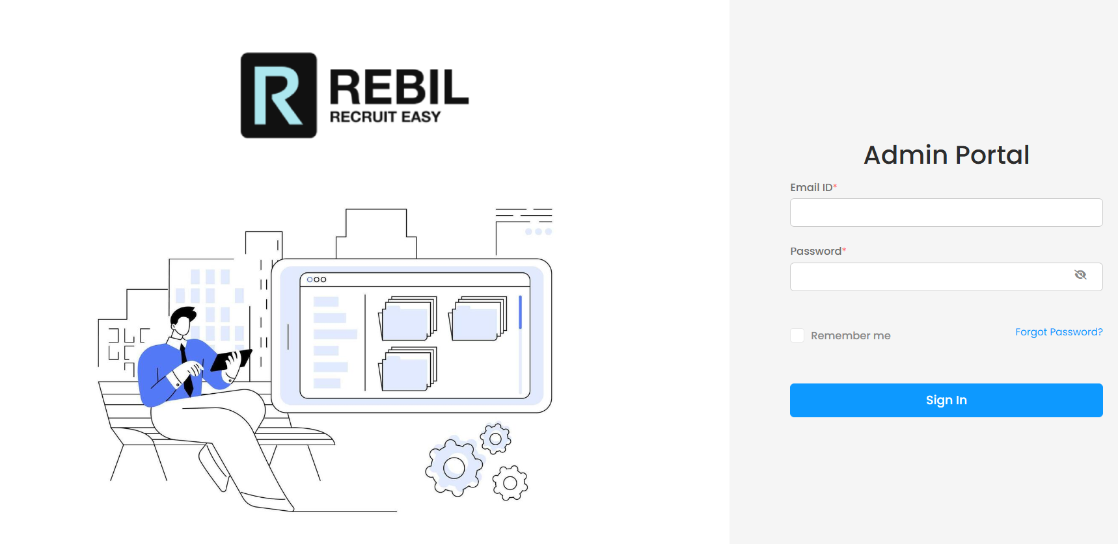
Screenshots
Admin Login Portal

Slide 5
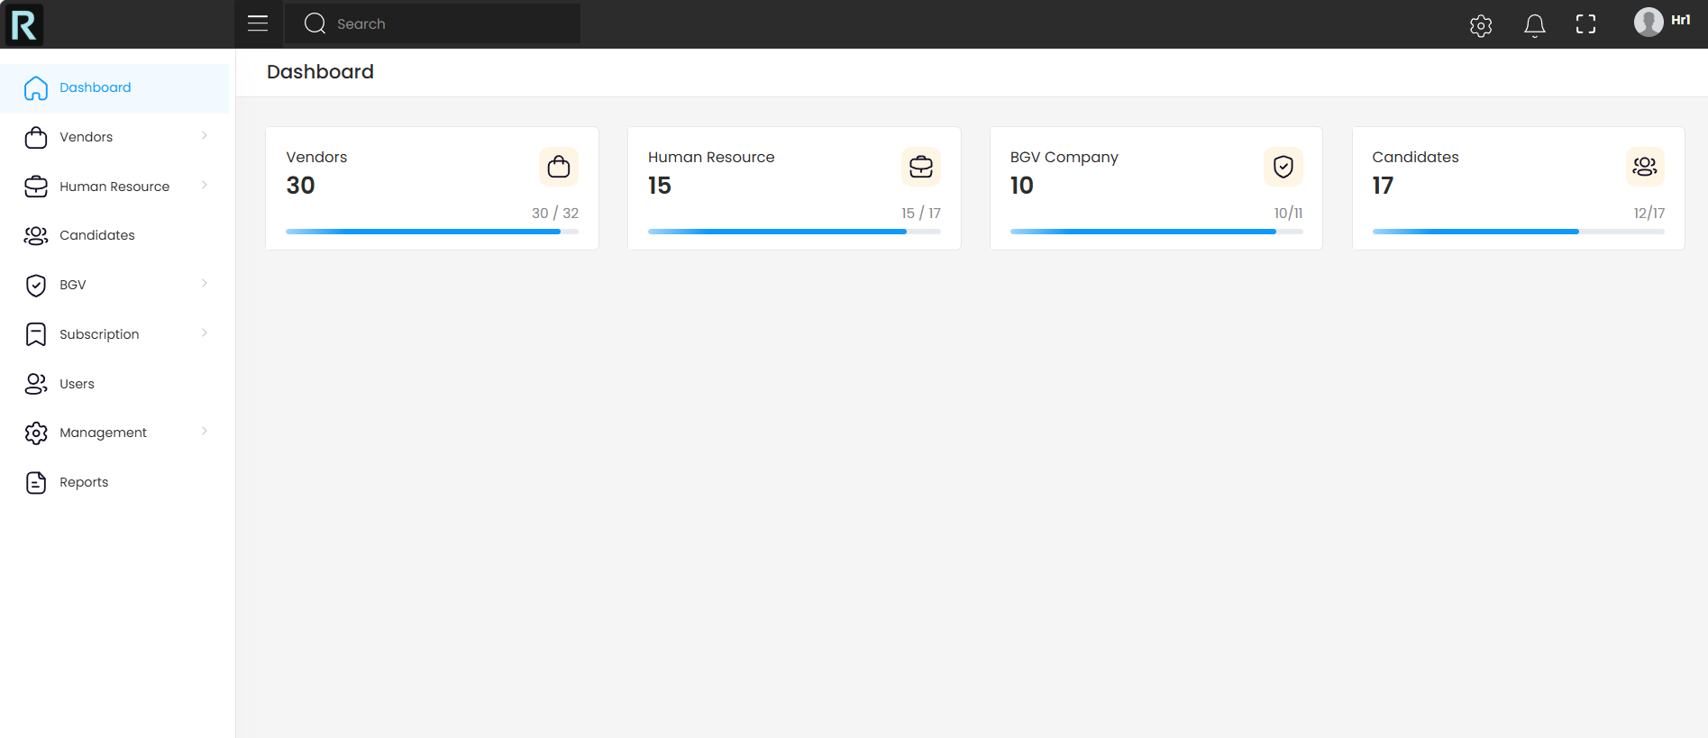
Admin Dashboard

Slide 6
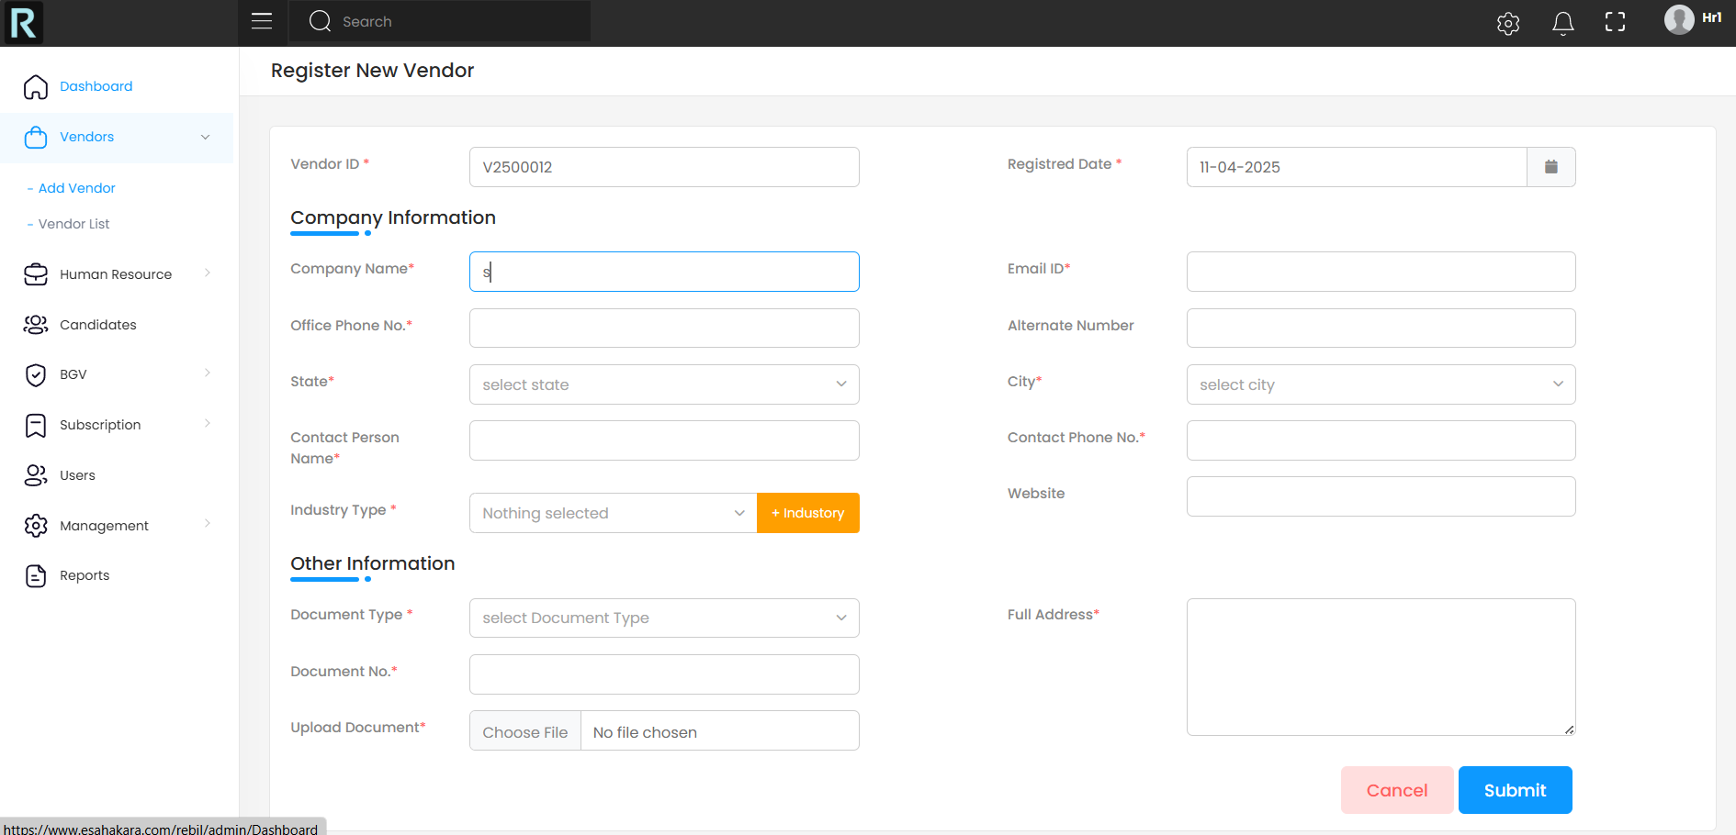
Vendor Registration

Slide 7
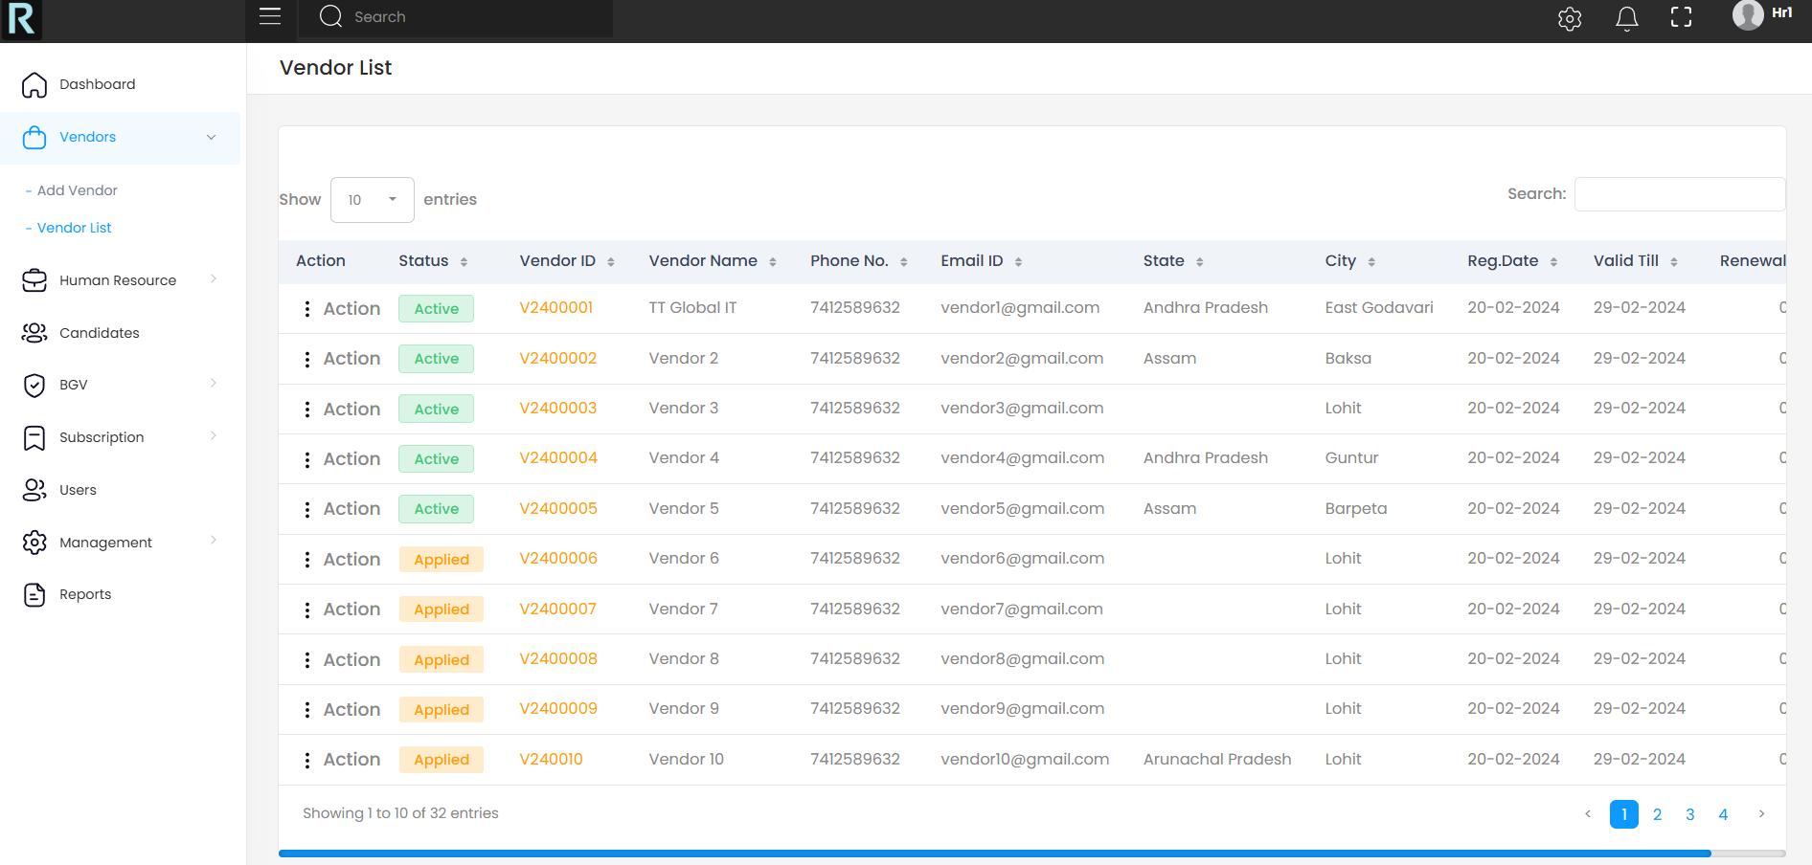
Vendor List

Slide 8
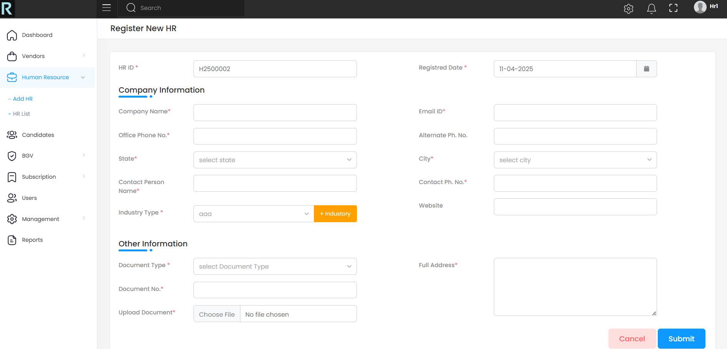
HR Registration

Slide 9
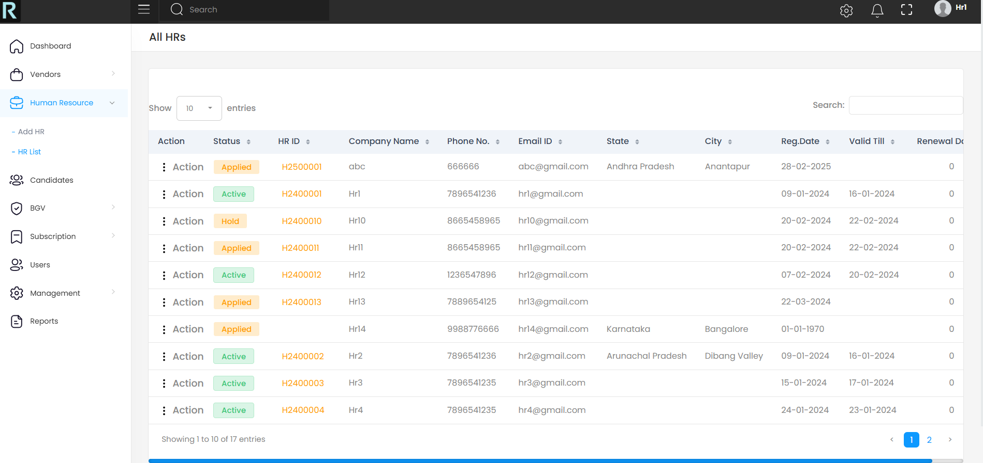
HR List

Slide 10
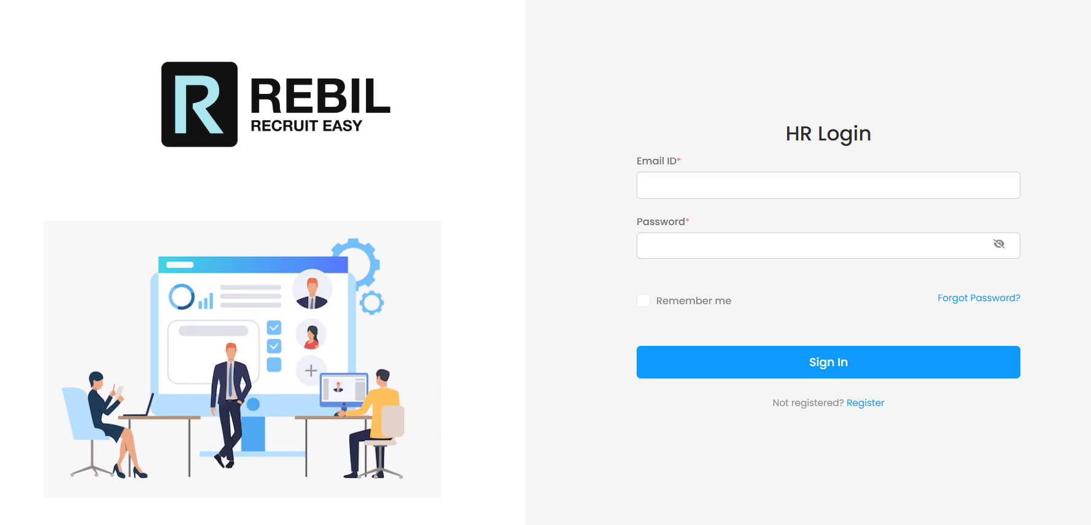
HR Login Portal

Slide 11

HR Registration Portal

Slide 12
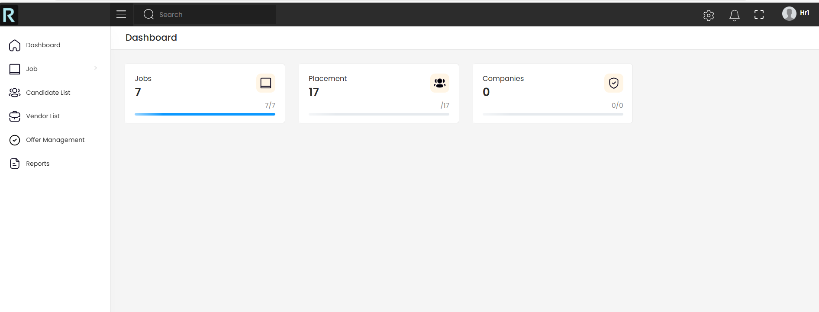
HR Dashboard

Slide 13
Github Link
GitHub Repository:
https://github.com/Deepak-kumar-Singh-D/Rebil

Slide 14


